Slide 1
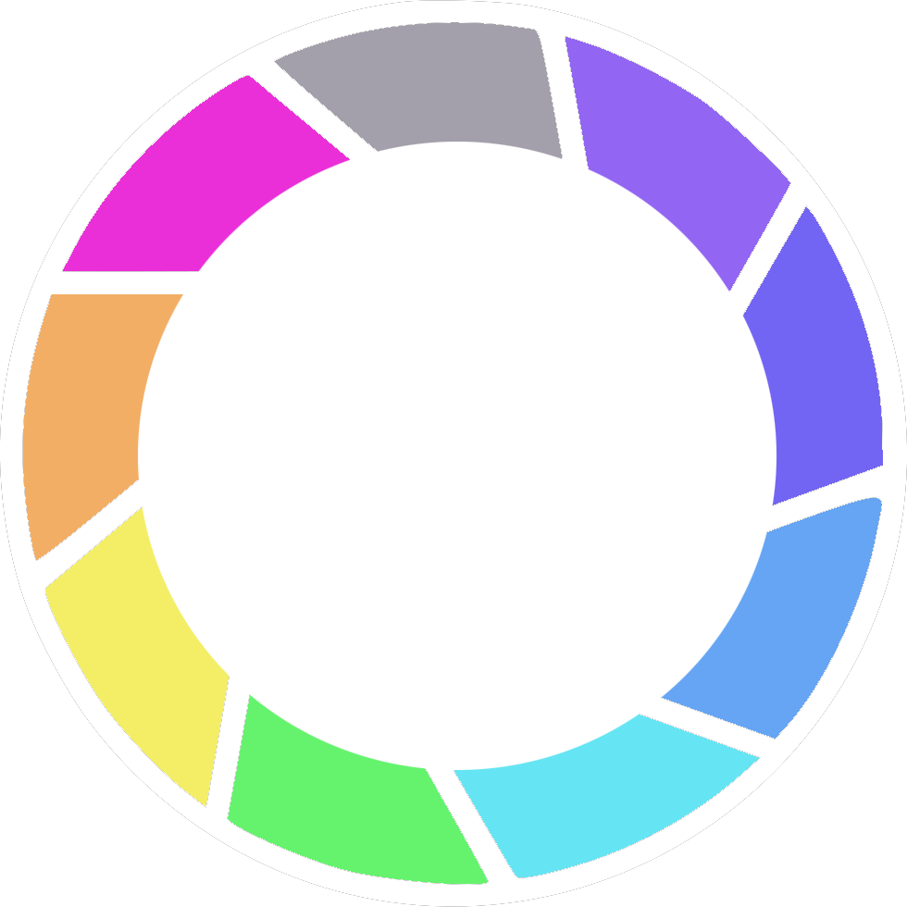
UX Design Taniti Tourism C856 Task 1 Lisa Kilker 2019

Slide 2
Timeline

Slide 3
Planning Timeline
Planning
Analytics
Prototyping
Build/Code
UCD
Wireframes
Launch
7 days
4 days
3 days
1 day
4 days
7 days
14 days
Research
Design
Conduct Stakeholder Interviews
Requirements Workshop
Competitor Benchmarking
Contextual Research
Analytics
Launch
Mockups
Page Deconstruction
Usability Testing
Personals
Interviews
Finalization
Code Product
Test and Revise
Sketching
Information Architecture

Slide 4
Personas

Slide 5
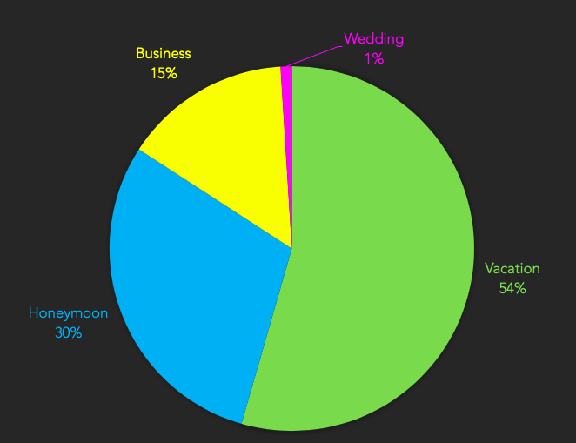
Data Analysis
*Based on Taniti government survey

Slide 6
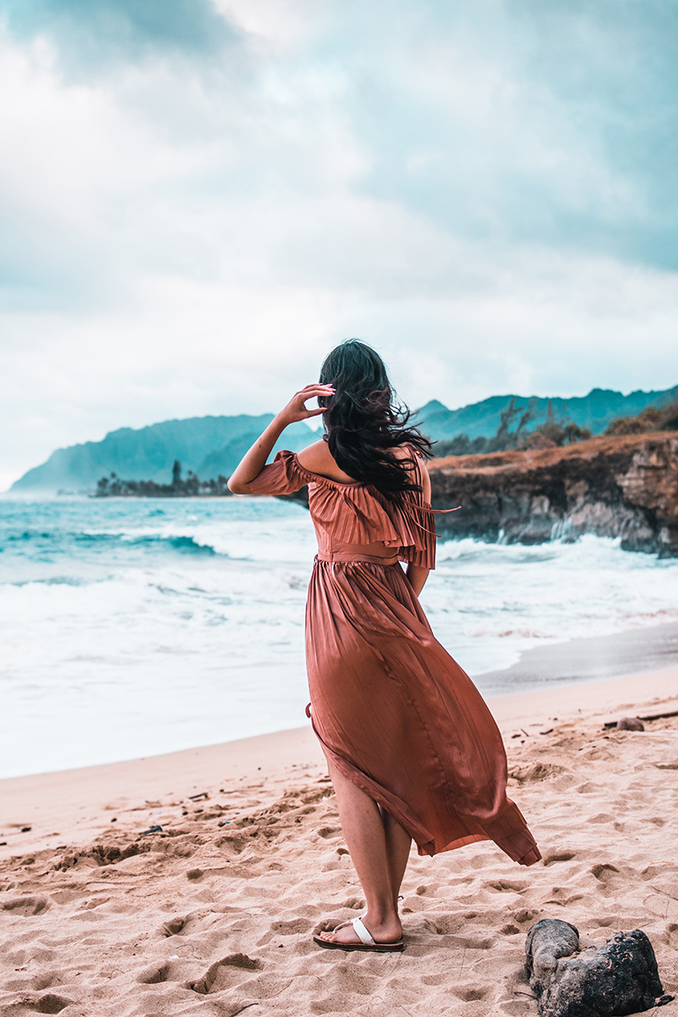
“The journey is the reward”
Attitude Towards Technology:
uses several devices regularly,
including laptop, tablet, and phone.
influenced by online ads, no print or television.
regular and steady use of social media
including Twitter, Facebook, and Instagram
The Independent Traveler
Female
Age 40
Married
No Children
USA
Marketing Director
$95,500 Salary
Context of Use: multi-device
Customer Segmentation Data: 65%
Key Drivers: looking for the
latest vacation hotspot
Businesswoman/
Globetrotter
Key goals and needs:
rental car company suggestions,
hotel special offers and discounts,
local attraction highlights and guided tours,
night life
Pain points: overwhelmed by choices,
overcrowded public spaces,
lack of Wi-Fi hotspots

Slide 7

“Where there’s waves…”
Attitude Towards Technology:
uses several devices regularly,
including laptop, tablet, and phone.
influenced by online ads, no print or television.
regular and steady use of social media
including Twitter, Facebook, and Instagram
The 20-Something Single
Male
Age 25
Single
No Children
USA
Surf Instructor
$25,000 Salary
Context of Use: multi-device
Customer Segmentation Data: 35%
Key Drivers: wants affordable accommodations
near the beach
Surf Expert/
Seafood Enthusiast
Key goals and needs:
surfing hot spots,
hotel special offers and discounts,
local bars and night life,
off-the-grid attractions
Pain points: overwhelmed by choices,
expensive meals and drinks,
bad weather

Slide 8

“Life’s too short”
Attitude Towards Technology:
uses several devices but not regularly.
devices include desktop computer, laptop,
and smartphone.
The Married Retiree
Male
Age 60
Married
Children
USA
Retired
$175,000 Salary
Context of Use: desktop computer
Customer Segmentation Data: 55%
Key Drivers: looking for a quiet getaway
with wife
Key goals and needs:
rental car company suggestions,
quiet places to relax,
local attraction highlights and guided tours,
all-inclusive meals
Booklover/
Husband/
Father
Pain points: loud, young travelers,
overcrowded public spaces,
dirty hotel amenities

Slide 9
Wireframes

Slide 10








Site Map
Homepage
Main Navigation
Hotels
Transportation
Things to do
Business
Contact us
Footer
Privacy policy
Social links

Slide 11
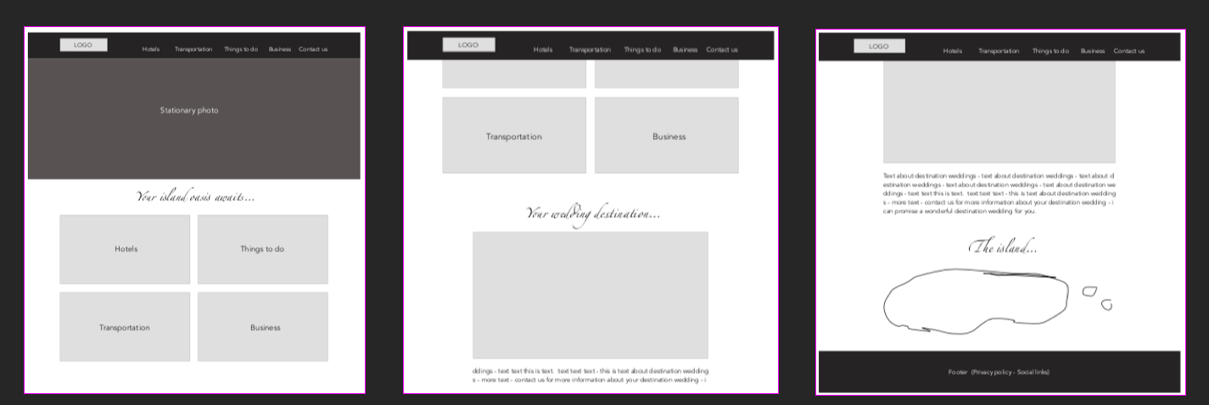
Homepage
Persistent header and footer
Logo that links back to home
Navigation links
Photos of main navigation with
links
Contact us navigates to footer
with email address
Destination wedding photo
and information
Map of island
Footer contains privacy policy
and social links

Slide 12
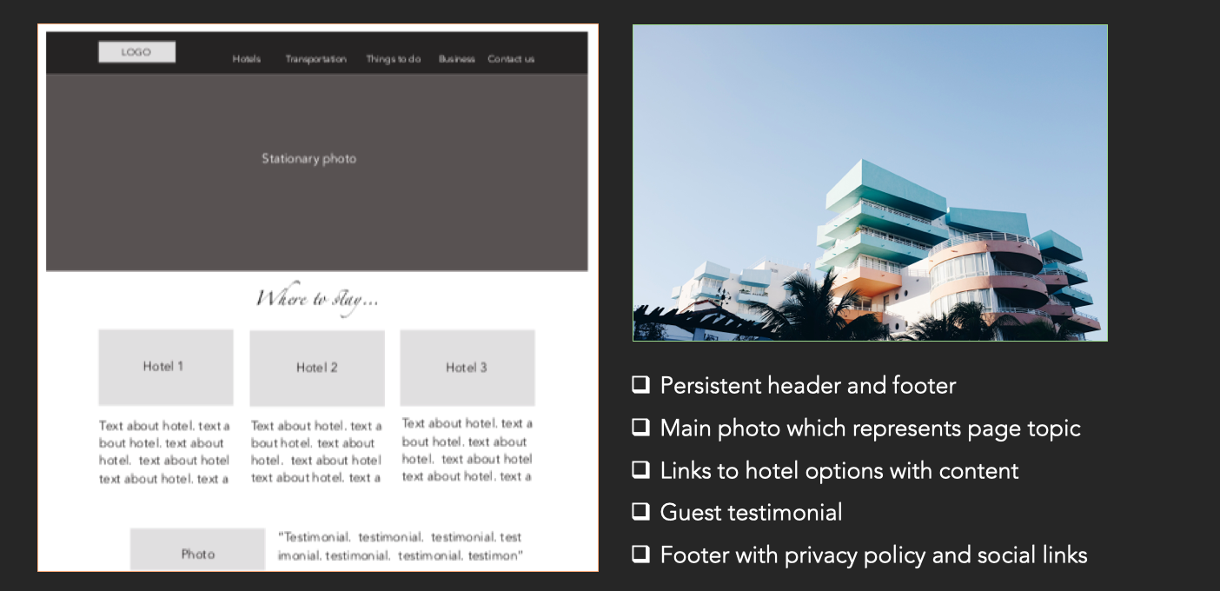
Hotels

Slide 13
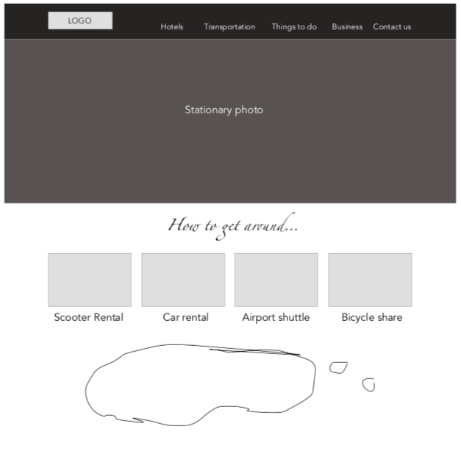

Transportation
Persistent header and footer
Main photo which represents page topic
Links to companies that partner for transportation
Map of the island
Footer with privacy policy and social links

Slide 14
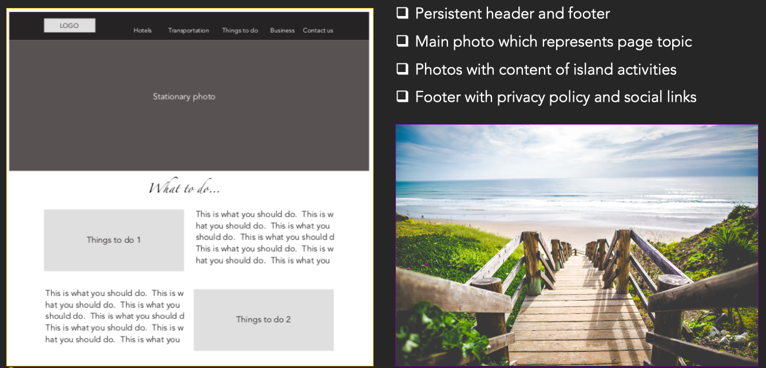
Things to do

Slide 15
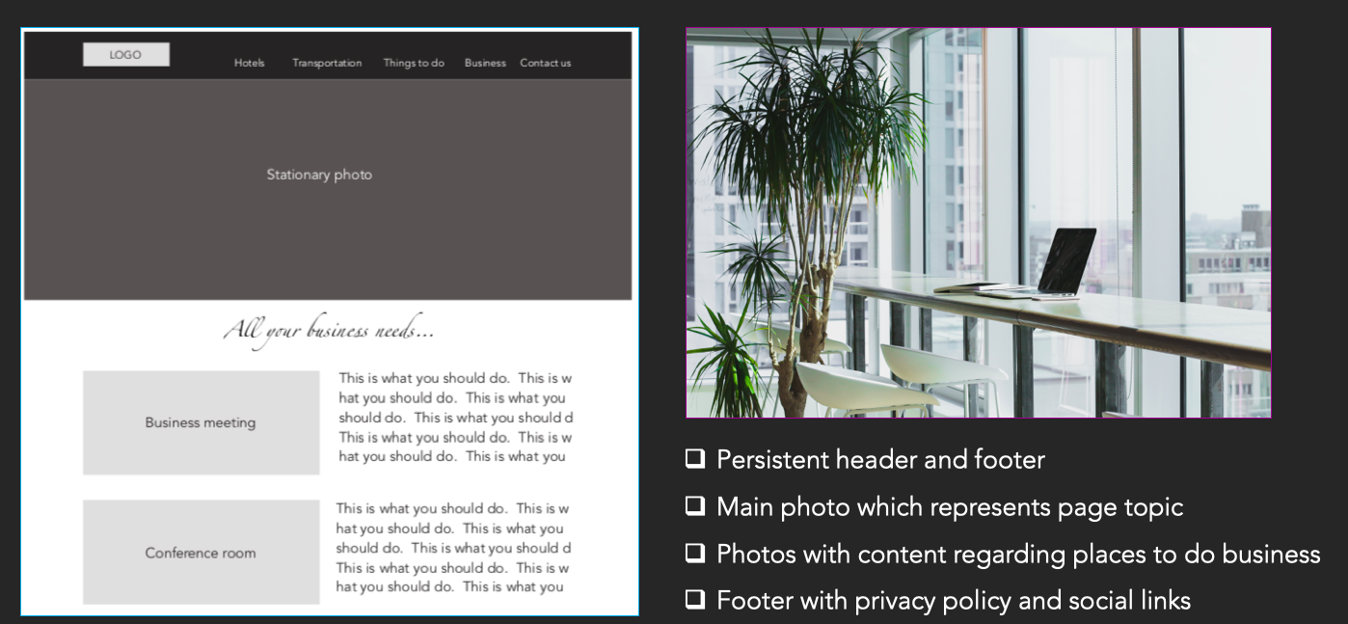
Business

Slide 16
Guerilla Testing

Slide 17



Users
Name: Elio (1)
Age: 33
Occupation: Film
Key thoughts: Thinks
the social media icons
should be in the navigation
bar.
Actionable: Yes
Name: Pam (2)
Age: 63
Occupation: Sales
Key thoughts: Wants
to see restaurants on
the “Things To Do” page.
Actionable: Yes
Name: Jim (3)
Age: 67
Occupation: Retired
Key thoughts: Has no
opinion. He’s hungry.
Thinks sports bars should
be featured.
Actionable: Yes

Slide 18

Summary
The overall feedback of the user testing was positive.
All three users loved the idea of the website remaining simple and easy to follow. User 1 thought that the social media links would be better at the top, but would be fine with them staying at the bottom. He also thinks that on the “Transportation” page, the links should be rearranged in order of importance: Airport shuttle, car rental, scooter rental, bicycle share.
User 2 believes that restaurants should be a main feature on the “Things to do” page. She also loved the simplicity of the site and said it was easy to follow and the follow worked just fine. She said she would prefer a different icon for the “social media” link. User 3 wanted a snack and thought sports bars should be the most important thing on the “Things To Do” page.

Slide 19

Incorporating Feedback
All their suggestions are easy to implement.
The suggestion regarding putting the social links in the top page, I’m not going to implement. I think they will be fine in the footer. I will change the icon for the social media so it’s not a megaphone, per User 2’s request. I will also make sure that restaurants are prominently featured on the “Things to do” page. Lastly, I will rearrange the links on the “Transportation” page to be in order by how the guest would probably be needing them, per User 1’s request.

Slide 20
Initial Interactive Prototype

Slide 21
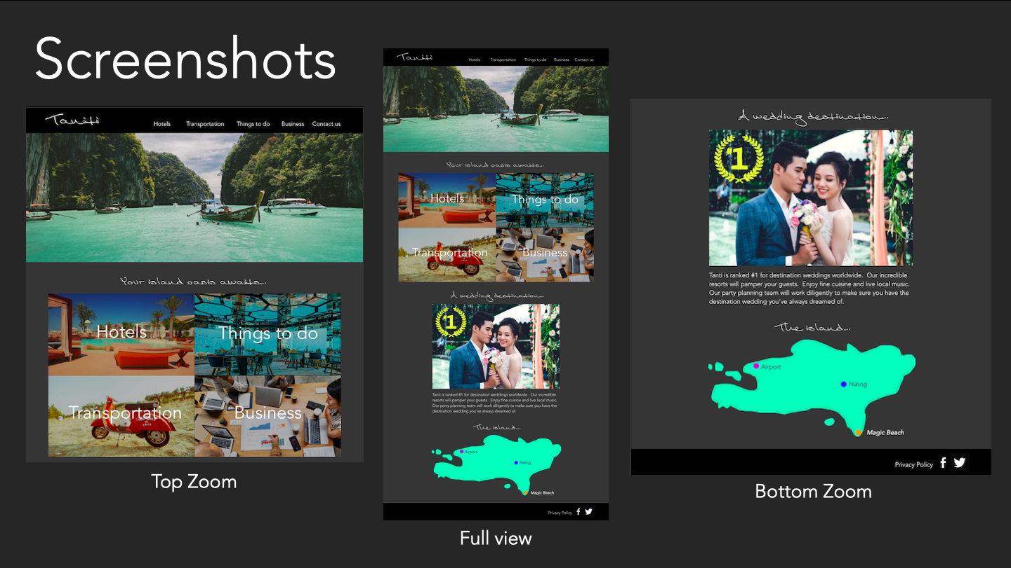

Slide 22
Prototype
Website prototype can be found here:
https://invis.io/JKPY9L2MNEF
All photos and vectors sourced from non-credit websites
Photos: Unsplash (2019, Jan 13). Retrieved from https://unsplash.com/
Vectors: Freepik (2019, Jan 13). Retrieved from https://www.freepik.com/

